Slide 1
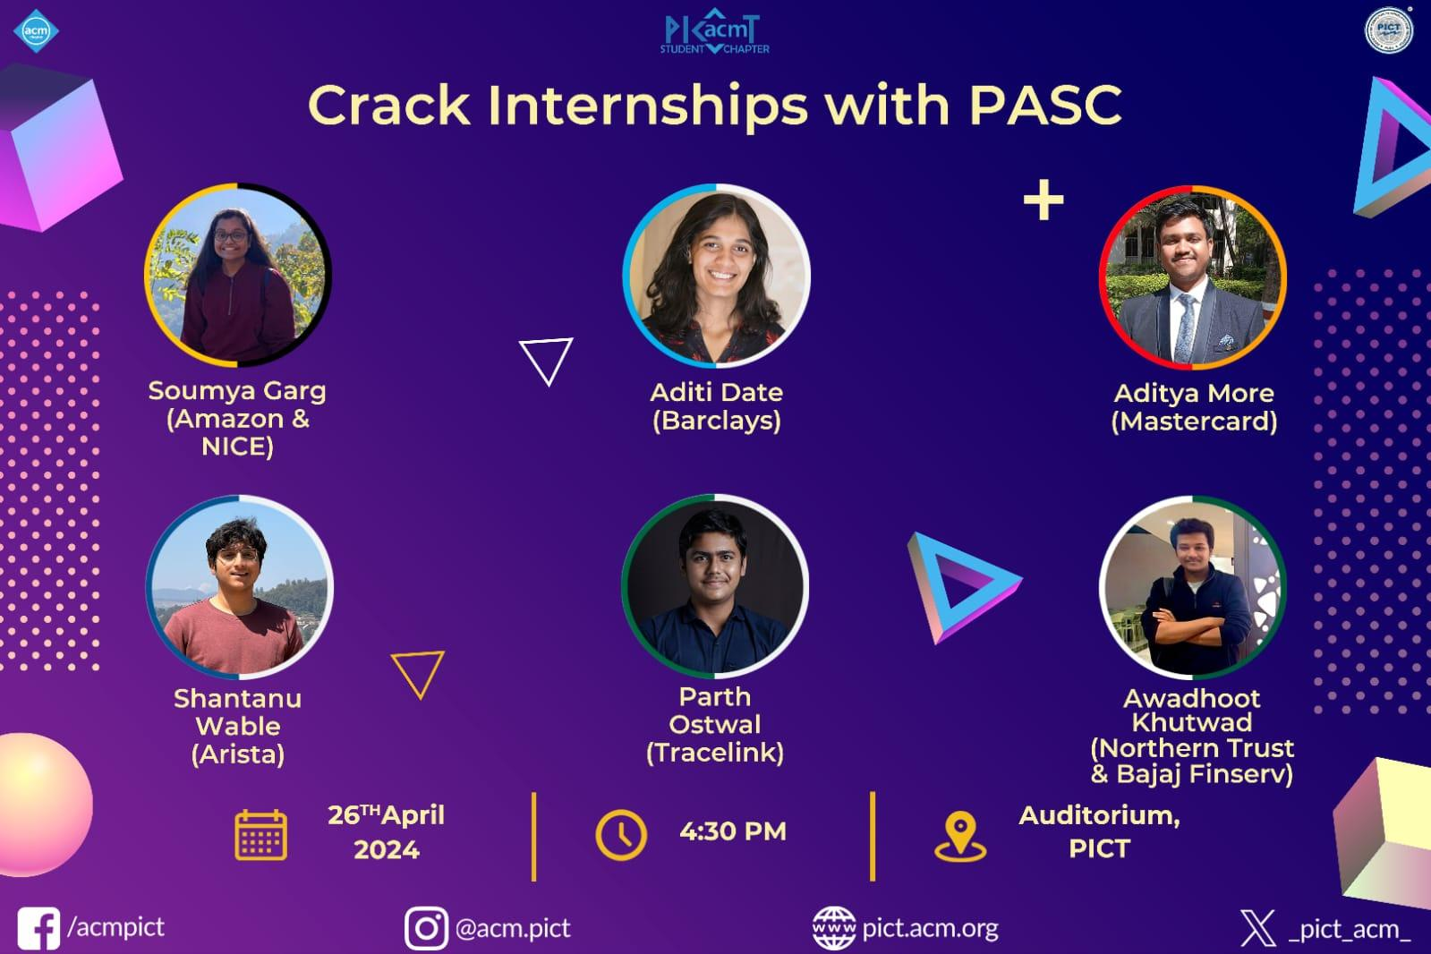

Slide 2



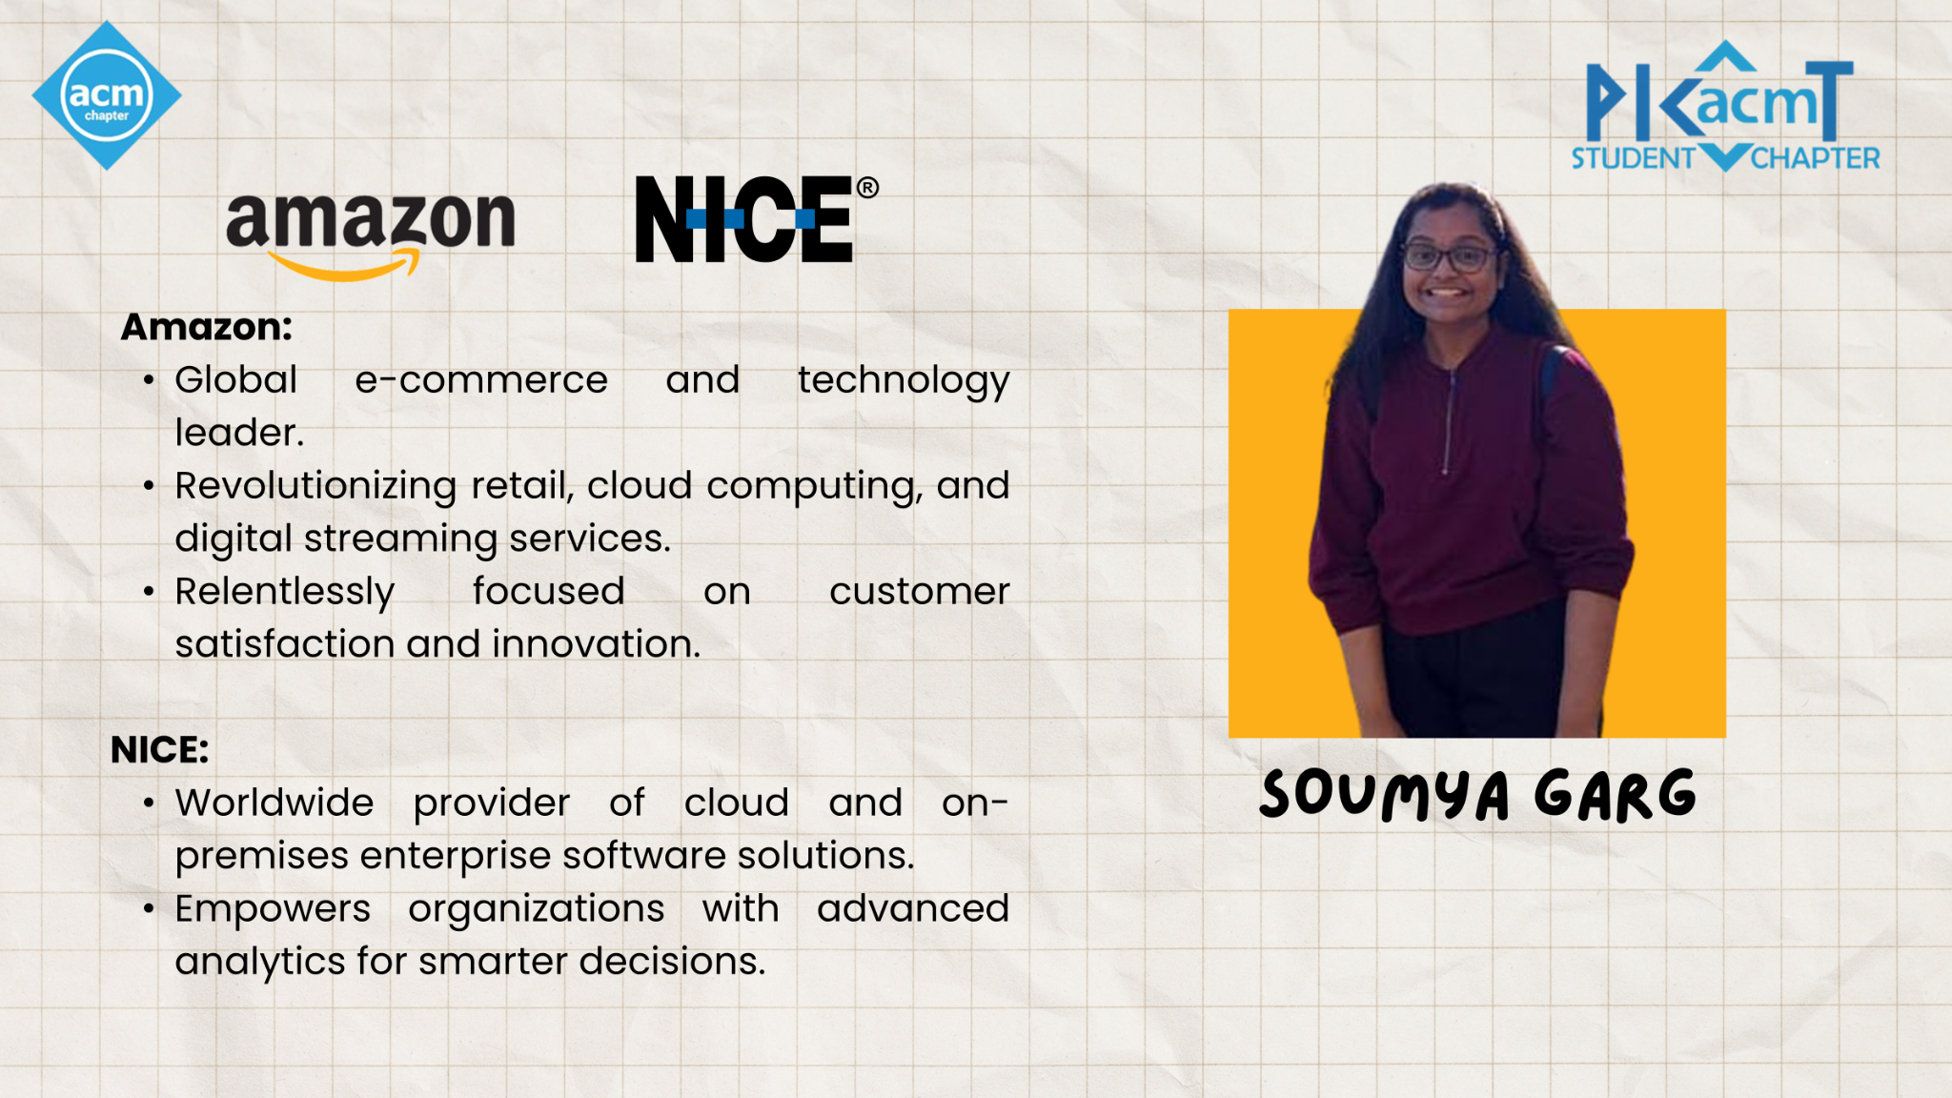








CRACK INTERNSHIPS
WITH PASC

Slide 3

Roadmaps to Internships
Summer Internships - After sem 6 mostly from (May to July)
Academic Internships - Part of the SPPU syllabus (to be finished in third year)
Coding Rounds
Technical Interview & HR Rounds
Projects & Resume
Core Subjects

Slide 4

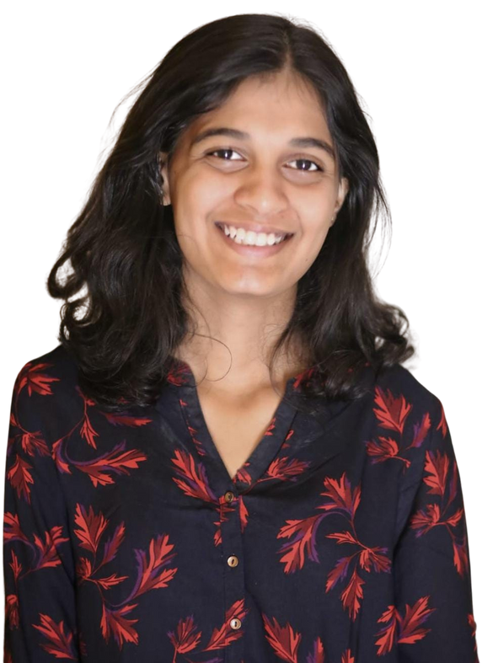
A well-established institution with over 300 years of history.
Offers a wide range of financial services including retail and corporate banking, investment banking, and wealth management worldwide.
Known for being innovative and responsive to customer needs.
Committed to maintaining integrity and conducting business responsibly.
ADITI DATE

Slide 5
Core Subjects
Make Notes
Many Resources available online
There are some common questions that are directly asked in interviews
Level of questions depends on company to company

Slide 6

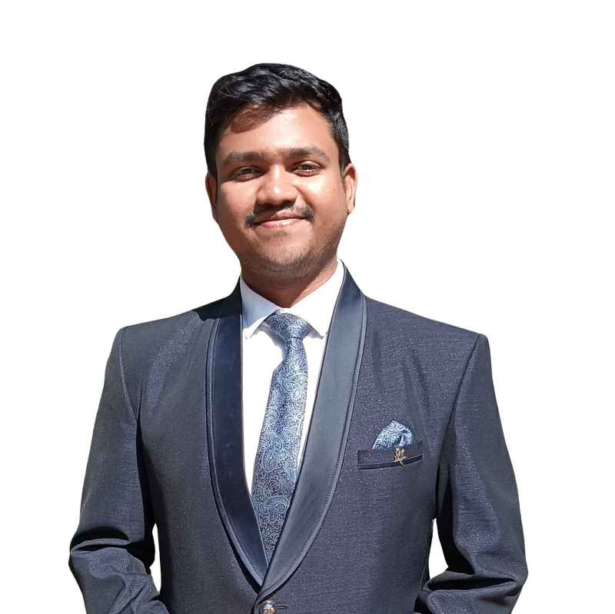
Global technology company in the payments industry.
Mission to connect and power an inclusive, digital economy.
Focus on making transactions safe, simple, smart, and accessible.
Innovations and solutions benefit individuals, financial institutions, governments, and businesses.
Decency quotient (DQ) drives company culture and actions.
ADITYA MORE

Slide 7
Interview
Offline interviews are very different from online
You may be asked to code in front of the interviewer
You should start with explanation of the question
Do not just directly code and give the answer
Always show positive approach even if you don’t know the answer

Slide 8


Arista Networks leads the way in data-centric networking solutions for various settings like big data centers, campuses, and routing infrastructures.
Known for its advanced platforms, Arista provides top-notch solutions that focus on availability, agility, automation, analytics, and security.
Users can effectively tackle changing networking issues thanks to the company's powerful network operating stack.
Arista's drive for innovation and quality is clear in its mission to provide cutting-edge networking solutions that meet the ever-changing demands of today's businesses.
SHANTANU WABLE

Slide 9
Resume
Use overleaf for creating your resume
Write proper explanation for your projects and internships
Highlight key terms
Give proper links to profiles, projects or any other achievements
Update your resume regularly and maintain different versions on drive

Slide 10
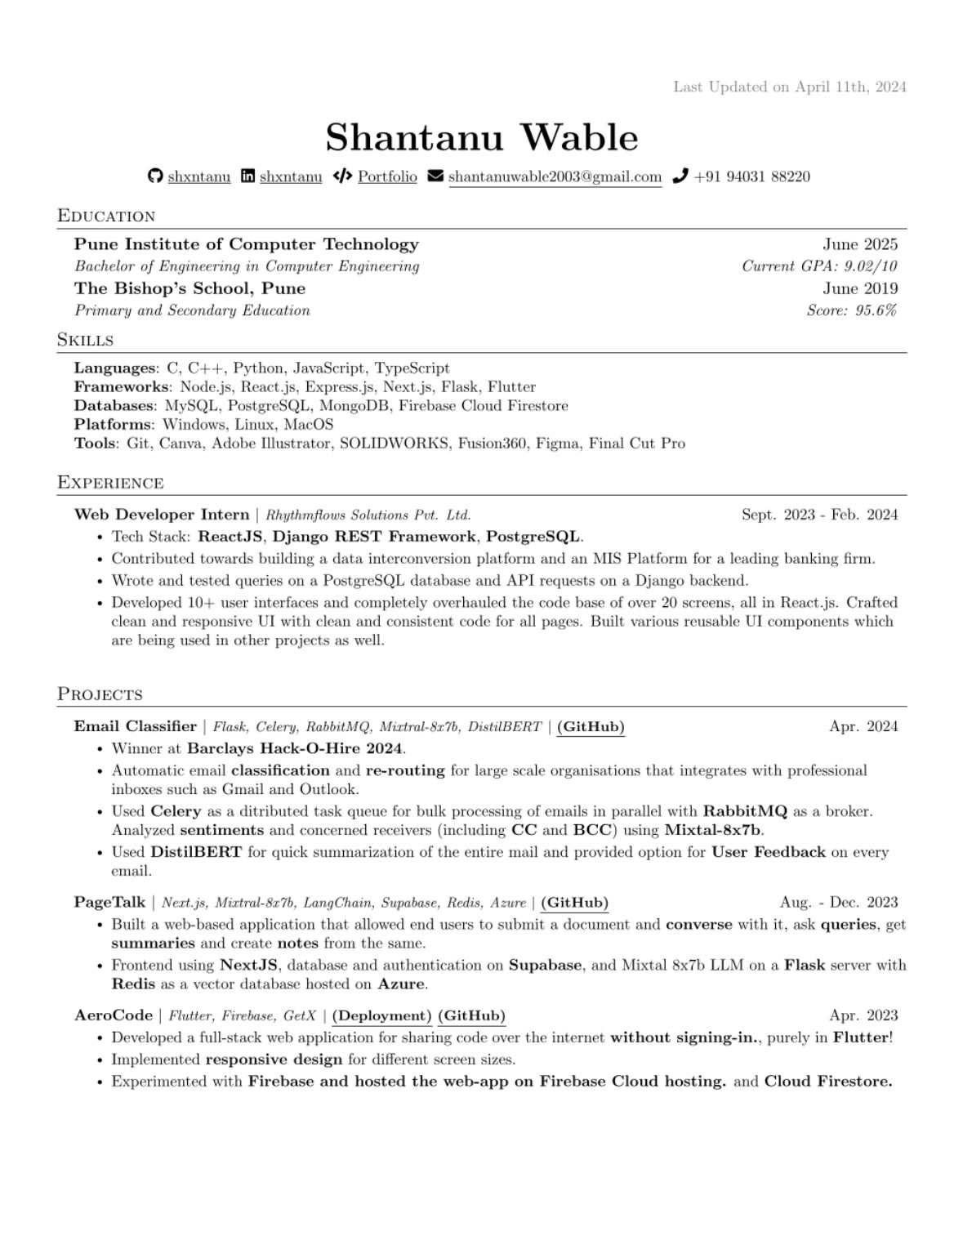

Slide 11
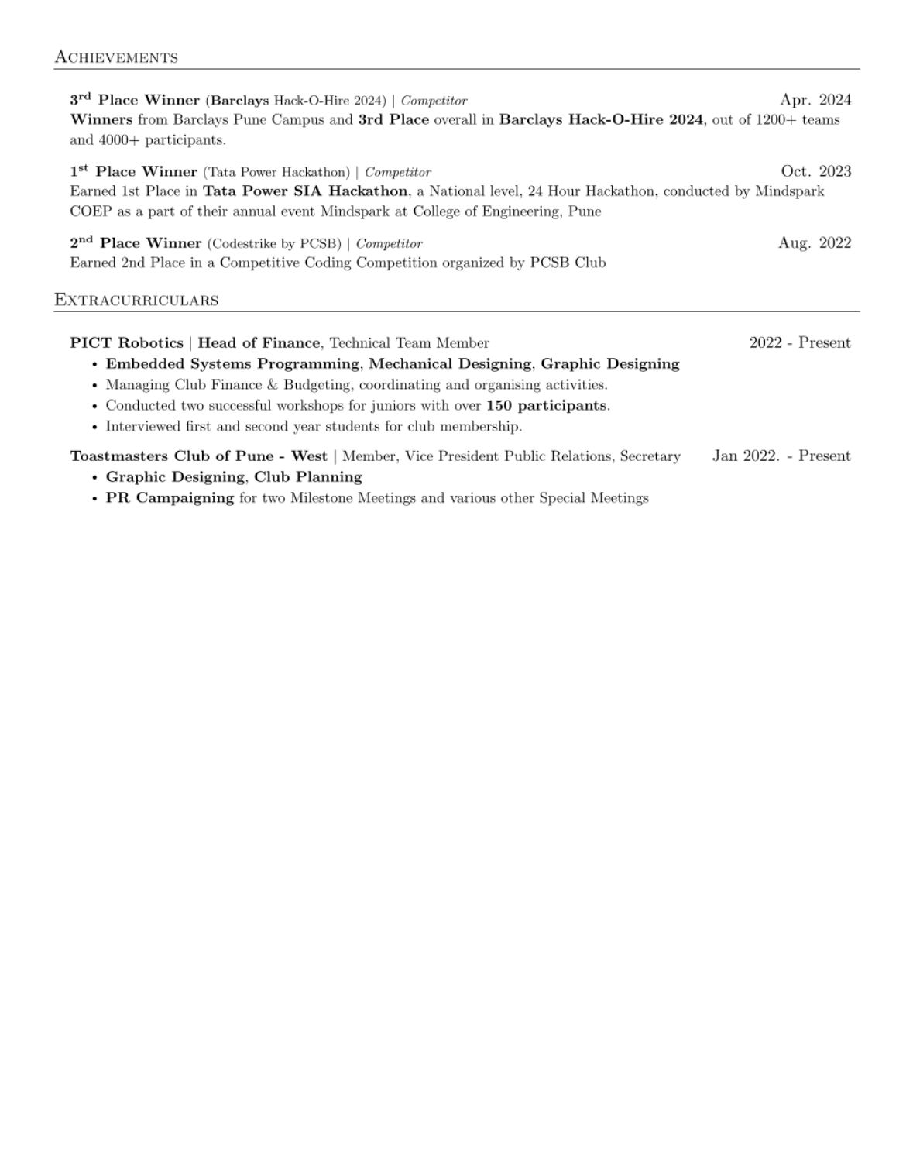

Slide 12

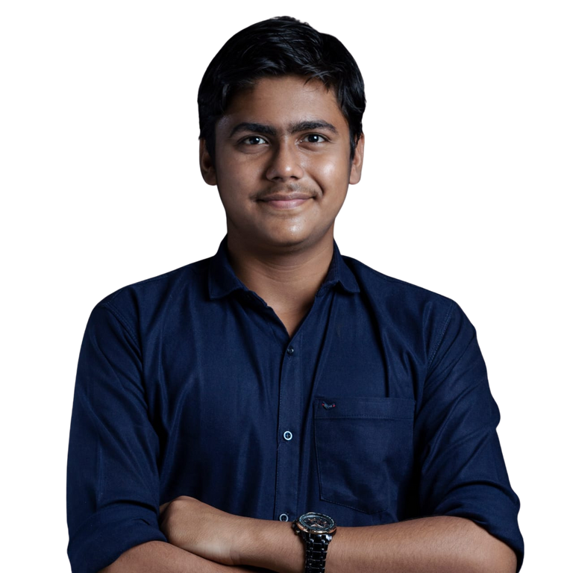
TraceLink is a pioneering network creation platform company that specializes in building integrated business ecosystems.
The company focuses on multienterprise applications, which serve as the fundamental infrastructure for digital transformation initiatives.
TraceLink's approach emphasizes customer-centric agility and resiliency, enhancing end-to-end supply networks to meet the demands of modern businesses.
Leveraging the collective intelligence of entire industries, TraceLink facilitates collaboration and innovation across supply chains.
PARTH OSTWAL

Slide 13
DSA and Competitive Programming
TRY
LEARN
FAIL

Slide 14



Northern Trust:
Renowned for exceptional client service and innovative solutions, Northern Trust is a premier global asset management and wealth management firm.
With a legacy spanning over a century, Northern Trust has earned the trust of institutions, corporations, and affluent individuals worldwide.
Bajaj Finserv:
Diversified financial services company in India.
Provides innovative financial products to millions using technology.
AWADHOOT KHUTWAD

Slide 15
Projects and Internships
Atleast one project which shows your skills
Internships are not necessary but if you have any past experience may help you in interviews.

Slide 16

QNA

Slide 17


Slide 18




THANK YOU!

